Slide 1
Crunchy Corner Business Optimization using Data Analytics
By: Vindeep Singh

Slide 2

Agenda
Understanding the Business
Financial Performance Analysis
Optimizing Business:
- Cost Analysis
- SKU Level Turnover Analysis
- Budgeted Analysis
- Cluster Head Analysis
- Mekko Chart Analysis
- Quadrant Analysis
- Pareto Analysis
- Gross Profit, Net Revenue & Volume Analysis
- Gross Profit & Net Revenue Variance Analysis

Slide 3

Understanding The Business

Slide 4
About The Company & Its Requirement
Crunchy Corner is one of India largest Fast Foods restaurant chain and serving millions of customer daily across various cities in India with more than 1000 restaurant and have largest SKU in the industry
The company(our client) is looking for dashboard where it can check its financial performance and understand how it can optimize its business and budgeting

Slide 5

Financial Performance Analysis

Slide 6

Performance Dashboard View

Slide 7
For the KPIs, we have 4 options: YTD, Total, YoY%(Year-on-Year % Growth), YoY% YTD(Year-on-Year % YTD)
YTD : This represents the cumulative performance from the beginning of the current year to the present date.
Total : This is the cumulative value from the beginning of time to the present date.
YoY% : This is the percentage change in a metric compared to the same period in the previous year.
YoY% YTD : This is the percentage change in a metric from the beginning of the current year compared to the same period in the previous year.

Slide 8
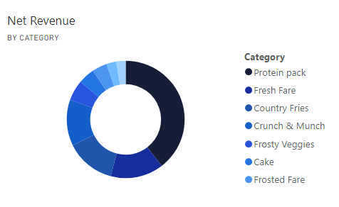
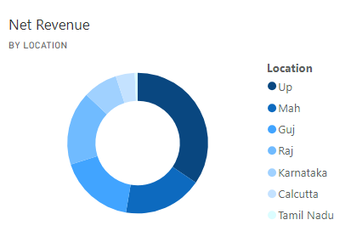
The ‘Protein Pack’ category has the most Net Revenue, as compared to all other categories.
‘UP’ state/location drives most Net Revenue, as compared to all other categories.

Slide 9

Optimizing Business

Slide 10
Cost Analysis
Insights:
The total cost in all the years from 2020 to 2024 has been near around 111 Million. In other words, there isn’t much variance in the total costs over the operating years
In all types of costs, the RM(Raw Material) cost is the most incurred cost by the company, with around 278.62 millions spent solely on raw materials procurement and/or processing.
In terms of total expenditure, the protein pack product category has the biggest share of expenditure, this could be because this category is the best selling category, thus, the firm products of this category more, leading to more share of this category in the total cost
In terms of location, the UP state has the biggest share in total expenditure. This seems also reasonable because the UP state has the biggest share in the sales.

Slide 11
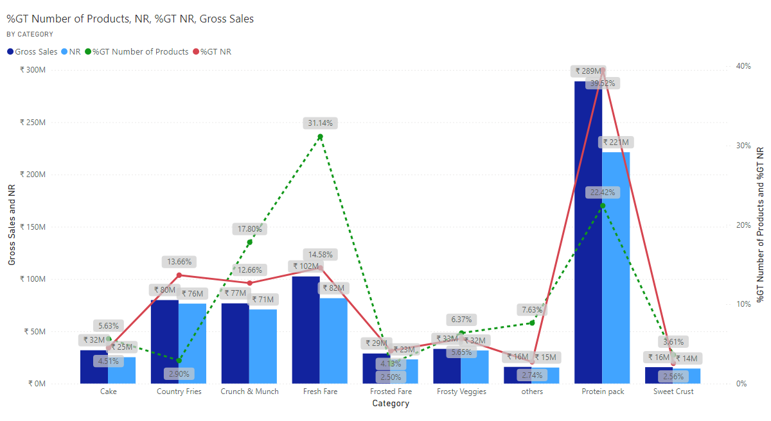
SKU Level Turnover Analysis
Insights:
The Protein Pack category has the highest number of Gross Sales, Net Revenue and % of Net Revenue(out of grand total), as compared to all other categories.
After ‘Protein Pack’ category, ‘Fresh Fare’ category has the highest Gross Sales and Net Revenue. However, it has the highest Number of Products(even higher than ‘Protein Pack’ category)
Open in Power BI QSR Power BI Advanced Dashboard Data as of 13/9/24, 6:50 pm

Slide 12
Budget Analysis

Slide 13
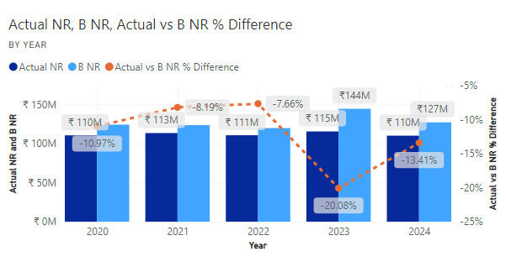
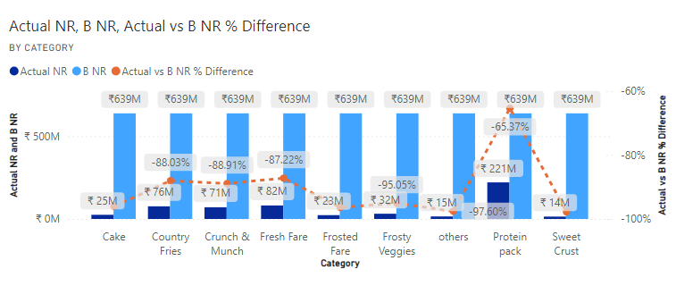
Open in Power BI QSR Power BI Advanced Dashboard Data as of 13/9/24, 10:10 pm
Open in Power BI QSR Power BI Advanced Dashboard Data as of 13/9/24, 10:10 pm
In all the operating years of the business(i.e, from year 2020 to 2024), the actual Net revenue has always been lower than the budgeted Net Revenue
In the previous year(2023), the difference between the actual and the budgeted Net Revenue was the highest(as we can see the actual Net Revenue is around 20.08% lower than the budgeted Net Revenue in the year 2023, which is the biggest difference when compared to all other years)
Whereas in the year 2022, the difference between the both was the lowest.
The budgeted Net Revenue is same across all the categories
Due to the Net Revenue for the ‘Protein Pack’ category being the highest, the % difference between the actual and the budgeted Net Revenue has been the lowest(as the actual Net Revenue is around 65.37% lower than budgeted Net Revenue, this difference is the lowest for this category, when compared to all other categories)

Slide 14
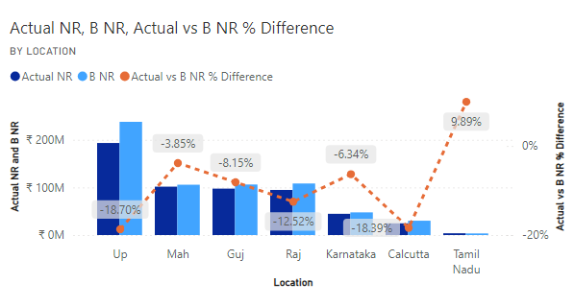
Open in Power BI QSR Power BI Advanced Dashboard Data as of 13/9/24, 10:10 pm
Out of all the states where the business is conducted, UP has highest actual and highest budgeted Net Revenue.
However, UP has the largest difference between the actual and the budgeted Net Revenue. Another state in spotlight in this aspect is Karnataka, with 2nd highest (18.39%) difference between the actual and the projected Net Revenue
On the other hand, Maharashtra state has the lowest difference between actual and the budgeted Net Revenue
The budgeted Net Revenue is same across all the categories
Due to the Net Revenue for the ‘Protein Pack’ category being the highest, the % difference between the actual and the budgeted Net Revenue has been the lowest(as the actual Net Revenue is around 65.37% lower than budgeted Net Revenue, this difference is the lowest for this category, when compared to all other categories)
NOTE: Just like how we have interpreted the visuals for the Net Revenue, similarly we can do so for other measures like Gross Sales, Gross Profit, Net Profit, and Total Expenditure

Slide 15
Cluster Head Analysis
INSIGHTS:
Out of all the Cluster Heads, Umar has been bringing the highest amount of Net Revenue, as compared to all other Cluster Heads. Umar is an extremely effective cluster head, who is bringing almost more than 50% (more specifically, 51.39%) of the Net Profit to the firm
After Umar, Kasfur is the 2nd highest perfoming Cluster Head in terms of Net Revenue as well as Net Profit %(out of Grand Total)
However, Dhiraj has the highest % of Gross Profit, even when he’s having very low(2nd lowest) number of products when compared to all other Cluster Heads. This could mean that he’s working on such few product types which have high Gross Profit margins, as compared to other product types.
Bilal is the lowest performing Cluster Head in terms of Net Revenue

Slide 16
Mekko Chart Analysis
INSIGHTS:
In this chart, the width of the bar represents the share in Net Revenue and the data label(like 0.22, 0.31, etc.) represents the % share of Number of Products(out of total of the firm’s products) . This chart can help us simultaneously analyze the product category’s share in Net Revenue and the % of number of products share in total products of the firm
Out of all the product categories, ‘Protein Pack’ category is the best performing category in terms of Net Revenue, given that it has the most width as compared to the other categories and consists of only around 22% of the total products offered by the firm
After Protein Pack, the ‘Fresh Fare’ category is highest performing in terms of Net Revenue and consists of around 31% of products out of the total products offered by the firm
Another notable and ideal category is ‘Country Fries’(which has subcategory ‘Frozen Fries’), which has very less % of products (around 3%) out of firms’ all products, but still has the 3rd highest Net Revenue compared to all other categories. Similarly, categories like ‘Cake’, ‘Frosted Fare’, ‘Sweet Crust’, ‘others’(subcategory: Heinz) have very less % of products, but they have comparatively less share in Net Revenue than other high performing categories

Slide 17
Quadrant Analysis
INSIGHTS:
In this scatterplot chart, the x axis represents Net Revenue and the y axis represents Gross Profit. Also, the size of the bubble increases as the Net Revenue increases
Out of all the product categories, ‘Protein Pack’ category is the best performing category in terms of both Net Revenue, and Gross Profit.
After Protein Pack, the ‘Fresh Fare’ category is 2nd highest performing in terms of Net Revenue but is not 2nd highest performing in terms of Gross Profit at the same time. Instead, the 2nd highest category in terms of Gross Profit is ‘Country Fries’ category. So, given that firm has primary aim of profit maximization, it should focus more on ‘Country Fries’ category than ‘Fresh Fare’ category
The least performing category both in terms of Net Revenue and Gross Profit is ‘Forested Fare’ category

Slide 18
Pareto Analysis 1
INSIGHTS:
Only around 1.40% of the total of firm’s products contribute to around 35.82 % of the total of Net Revenue.
Similarly, only around 3.16% of the total of firm’s products contribute to around 50% (more specifically, around 50.01% )of the total of Net Revenue
Similarly, around 10.77% of the total of firms’ products contribute to exactly 75% of the total of Net Revenue
At last, only around 24.72% of the total of firm’s products contribute to exactly 90.01% of the total of Net Revenue.
The rest of the products(around 75% of the products) together contribute to only around 10% of Net Revenue.
Thus, the firm should be focusing more on only these 25% of its product, and dedicate less efforts and resources on the products with very less share in Net Revenue

Slide 19
Pareto Analysis 2
INSIGHTS:
Only around 1.40% of the total of firm’s products contribute to around 35.82 % of the total of Net Revenue.
Similarly, only around 3.16% of the total of firm’s products contribute to around 50% (more specifically, around 50.01% )of the total of Net Revenue
Similarly, around 10.77% of the total of firms’ products contribute to exactly 75% of the total of Net Revenue
At last, only around 24.72% of the total of firm’s products contribute to exactly 90.01% of the total of Net Revenue.
The rest of the products(around 75% of the products) together contribute to only around 10% of Net Revenue.
Thus, the firm should be focusing more on only these 25% of its product, and dedicate less efforts and resources on the products with very less share in Net Revenue

Slide 20
Pareto Analysis 3
INSIGHTS:
Only around 121 products contribute to 50 % of the total of firm’s Net Revenue.
Similarly, only around 216 products contribute to 60% of the total of firm’s Net Revenue
Similarly, only around 423 products contribute to exactly 75% of the total of Net Revenue
Similarly, only around 1,000 products contribute to exactly 90% of the total of Net Revenue
Similarly, only around 1445 products contribute to exactly 95% of the total of Net Revenue
The rest of around 2,762 products(i.e, around 65.6% of the firm’s products) contribute only the remaining 5% of Net Revenue.
Thus, the firm should be focusing mainly on around 1445, which are bringing 95% of the Net Revenue, and allocate less efforts and resources on the remaining 2,762 products with very less share in Net Revenue, or even stop producing and selling such products which bring almost no Net Revenue.

Slide 21
Gross Profit, Net Revenue & Volume Analysis
In this graph, the bars of categories having Gross Profit margin lower than the Average Gross Profit are colored as red, whereas the bars of categories having Gross Profit margin higher than the Average Gross Profit margin are colored as green
In this graph, the length of the bar (y axis) represents the Net Revenue of the concerned category
INSIGHTS:
The category ‘Protein Pack’ has the highest amount of Net Revenue(i.e, around 221 Million) when compared to all other categories. Also, it’s Gross Profit margin is higher than the average gross profit margin of all categories
After ‘Protein Pack’ category, the ‘Fresh Fare’ category is 2nd best performing category in terms of Net Revenue. However, the Gross Profit margin of this category is around 15.95%, which is very low when compared to the 29.01%, the average Gross Profit margin
Out of all the categories, the ‘Frosty Veggies’ category has the highest Gross Profit margin, which is around 40.45%
The categories like ‘Fresh Fare’, ‘Crunch & Munch’, ‘Frosted Fare’, and ‘others’ have lower than the average Gross Profit margin. The firm can try to optimize some major costs like Raw Materials Cost to increase the margins of such categories

Slide 22
Net Revenue and Gross Profit Variance Analysis
Here, we try to analyze the Gross Profit Variance % (the age difference between the actual and the budgeted Gross Profit), and the Net Revenue Variance % (the %age difference between the actual and the budgeted Net Revenue) for each major category, using a scatter plot
The conditional formatting used here is to serve the following purpose:
If Net Revenue Variance % is positive(i.e, > 0%) and the Gross Profit Variance % is also positive, then that concerned category is labelled as ‘More’. However. If the Gross Profit Variance % is negative, then the concerned category is labelled as ‘Misses’, if not, then it’s labelled as ‘Misses’
However, if Net Revenue Variance % is negative (i.e, < -1%) and if the Gross Profit Variance % is positive or negative but more than than -1%(like, -0.8%, -0.4%, and so on), then only the category will be labelled as ‘More’. If Gross Profit Variance % is more than -1%(like -2.5%, -4%, etc.), then the concerned category will be labelled as ‘Misses’. If none of the 2 conditions satisfied, then it’s labelled as ‘Meets’
In simple words, we are using this conditional formatting to analyze whether the category is having better performance than the budgeted performance or not(in terms of Net Revenue and Gross Profit)
INSIGHTS:
Over all the operating years of the business, the ‘Protein Pack’ category has performed better than all other categories, as it’s actual Net Revenue and Gross Profit are more closer to the budgeted Net Revenue and budgeted Gross Profit, respectively
However, like all other categories, ‘Protein Pack’ category’s actual Net Revenue and Gross Profit haven’t been to surpass the budgeted Net Revenue and budgeted Gross Profit, respectively, thus, like all other category, it is also labelled as ‘Misses’

Slide 23
Recommendations
The total cost in all the years from 2020 to 2024 has been near around 111 Million. In other words, there isn’t much variance in the total costs over the operating years. The management should look for various ways in order to try to minimize the costs.
In total costs incurred, the Raw Materials cost has the biggest share in the total costs. The management should look for various ways to minimize the Raw Materials cost, like contacting different suppliers, negotiating with existing suppliers for lower prices, optimize production process to reduce wastage and consumption of raw materials, use alternative materials having lower costs, simplify product designs to reduce materials wastage, etc.
Out of all the product categories, Protein Pack, Fresh Fare, Crunch & Munch, and Country Fries are the top performing categories in terms of Net Revenue, respectively. The management should try to allocate more investments to these winning categories
As per the budget analysis, the ‘Protein Pack’ has the least amount of gap between the actual and the budgeted Net Revenue, thus, management can focus more on this specific category. Also, the budgeted Net Revenue amount for all the categories is exactly the same, for all the other categories other than the ‘Protein Pack’ category, the management should be revising all the budgeted figures, as all the other categories’ Net Revenues are very far below the budgeted Net Revenues
As per the Cluster Head Analysis, Umar is the top-performing cluster head, who has directly or indirectly contributed to more than 50% of the Net Revenue. After Umar, Kafsur is the 2nd best performing cluster head both in terms of Net Revenue and Net Profit. The management should provide additional resources(like budget, staff, etc.) to both of these top performing heads, acknowledge their achievements through reward and offer better incentives, to keep them and the other heads motivated. Also more importantly, the management should analyze Umar and Kafsur’s strategies and tactics, and try to provide training to other cluster heads with such strategies and tactics
For low performing cluster heads, management should try to understand their challenges and obstacles, offer training and mentorship to enhance their skills, and provide additional resources which will hep them in aiding their performance
As per the Mekko Chart, Country Fries and Crunch & Munch categories are not only considered as top performing categories in terms of Net Revenue, but they also have very less number of products. Unlike other top performing categories like Protein Pack and Fresh Fare, the Country Fries and Crunch & Munch categories have very less number of products. Thus, the management should also focus on these categories, as it’s much easier to scale and boost the sales only few products, than focusing on thousand products simultaneously

Slide 24
As per Pareto Analysis, only around 3.16% of the total of firm’s products contribute to around 50% (more specifically, around 50.01% )of the total of Net Revenue. Similarly, around 10.77% of the total of firms’ products contribute to exactly 75% of the total of Net Revenue . At last, only around 24.72% of the total of firm’s products contribute to exactly 90.01% of the total of Net Revenue. This clearly indicates that the top performing the rest of around 75% of the products have much less share in the total Net Revenue of the firm. Thus, the management should be dedicating majority of its attention and focus only on these high-performing key products which have fetched the majority of the Net Revenue. The management can consider either reducing the production of the other products or stop the selling of such products which don’t contribute to the Net Revenue at all
In absolute terms, only around 1,455 out of total 4,207 products have fetched 95% of the Net Revenue. The management must allocate more efforts, resources and budget to these 1,455 products and boost their performance further. For the rest of the remaining products, the management should identify the key products which are performing well and consider removing such products which don’t seem to be having any significant share in Net Revenue and demand in the market
In the product categories, the Frosty Veggies category has the highest Gross Profit margin, whereas, the Frosted Fare category has the lowest Gross Profit margin (only around 7.2%). Given the management’s primary aim of profit maximization, the management should try various methods to boost the sales of products belonging to Frosty Veggies categories, via boosted advertising, offering coupons for this category to new customers, upselling this category’s products with other high selling products, making bundle of this category’s products with other top selling products, etc. Also, the management should look into increasing the margin of Frosted Fare category’s products(which have very low profit margins) by using low costing alternative materials, and optimizing marketing costs, and fixed & variable costs related to the products of this category
As per the variance analysis, sweet crust, frosted fare, cake and others categories have very low variance(i.e, they have very less actual Net Revenue and Gross Profit, in comparison to the budgeted Net Revenue and budgeted Gross Profit). Thus, the management needs to revise the budgeted figures of these low-performing product categories accordingly

Slide 25
Thank you
Vindeep Singh
vindeep500@gmail.com
+91 9013546390

